Slide 1
Smart Learning Management System
Presented By: Anum Zeb

Slide 2
Content:
Purpose
Tool
Architecture
Users
Features
App Images

Slide 3
Purpose
User can easily upload and download lecture related to specific course
Online learning can be a lifeline to those who have obstacles, such as geographical distances or physical disabilities. By: Paul Levenson

Slide 4
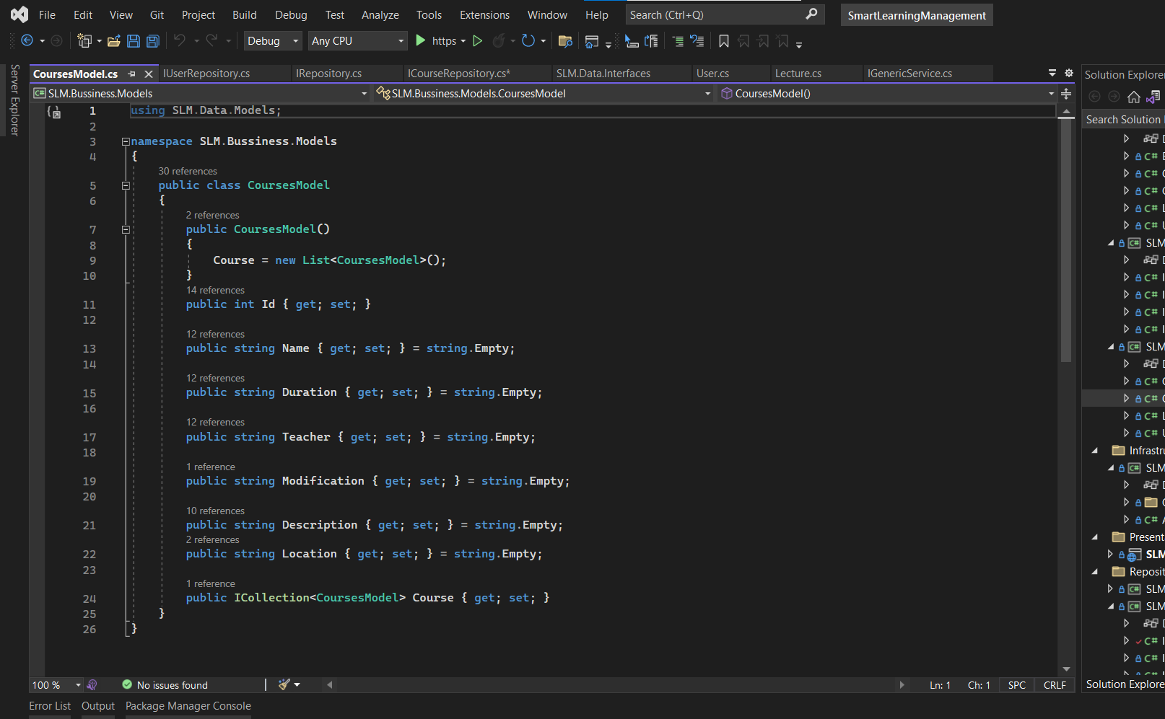
Tool
Visual Studio 2022
Microsoft SQL Server Management
Template: ASP. Net Core Web App (MVC)
Framework: .NET 6.O

Slide 5
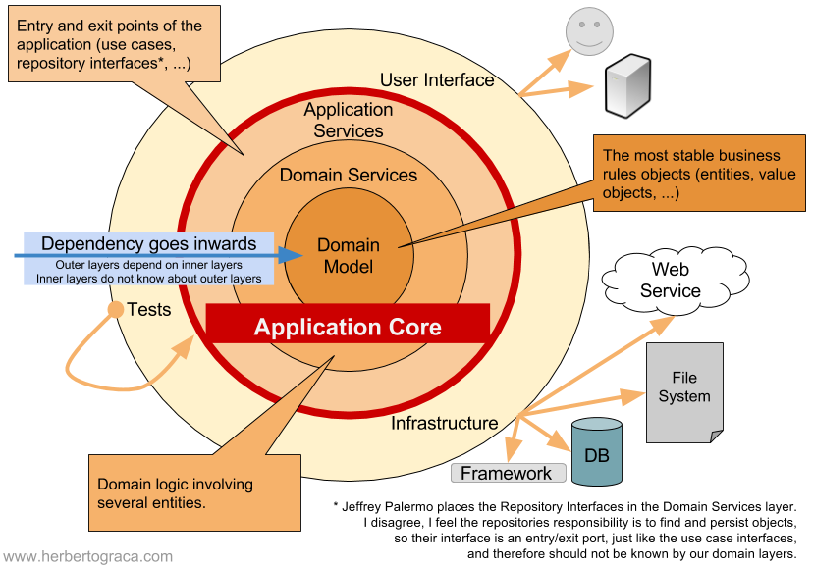
Architecture
Onion Architecture :
Domain Entities / Model
Domain Services / Repositories
Application Services / Service Interface
User Interface

Slide 6
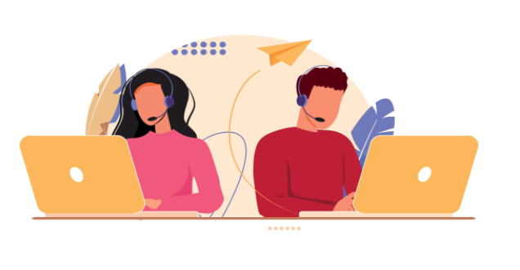
Users
Teacher
Student

Slide 7
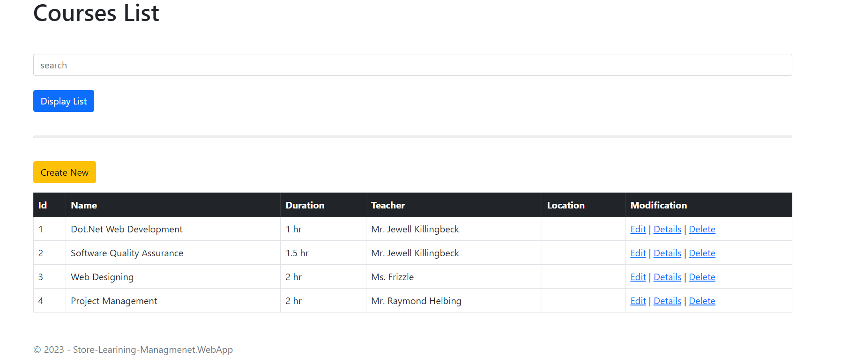
Features
Main Feature:
Courses:
Listing
Add
Edit
Delete
Search
Lecture:
Listing
Add
Edit
Delete

Slide 8
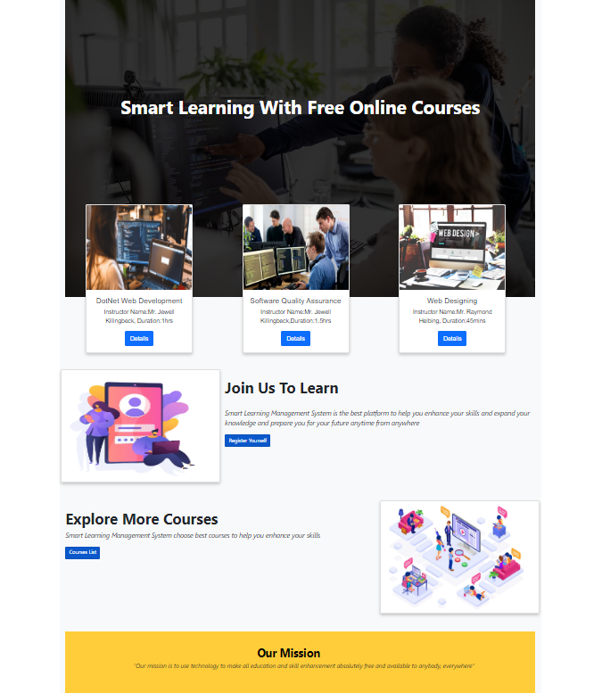
Features
Other Feature:
Homepage
Dashboard
Signup/ Login

Slide 9
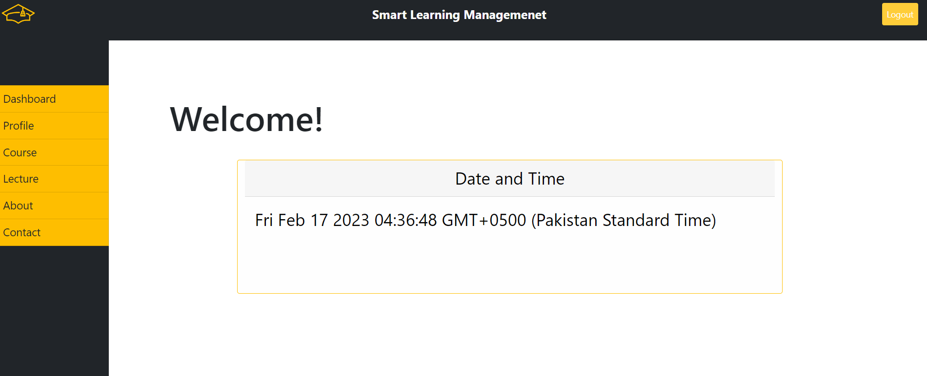
App Images

Slide 10
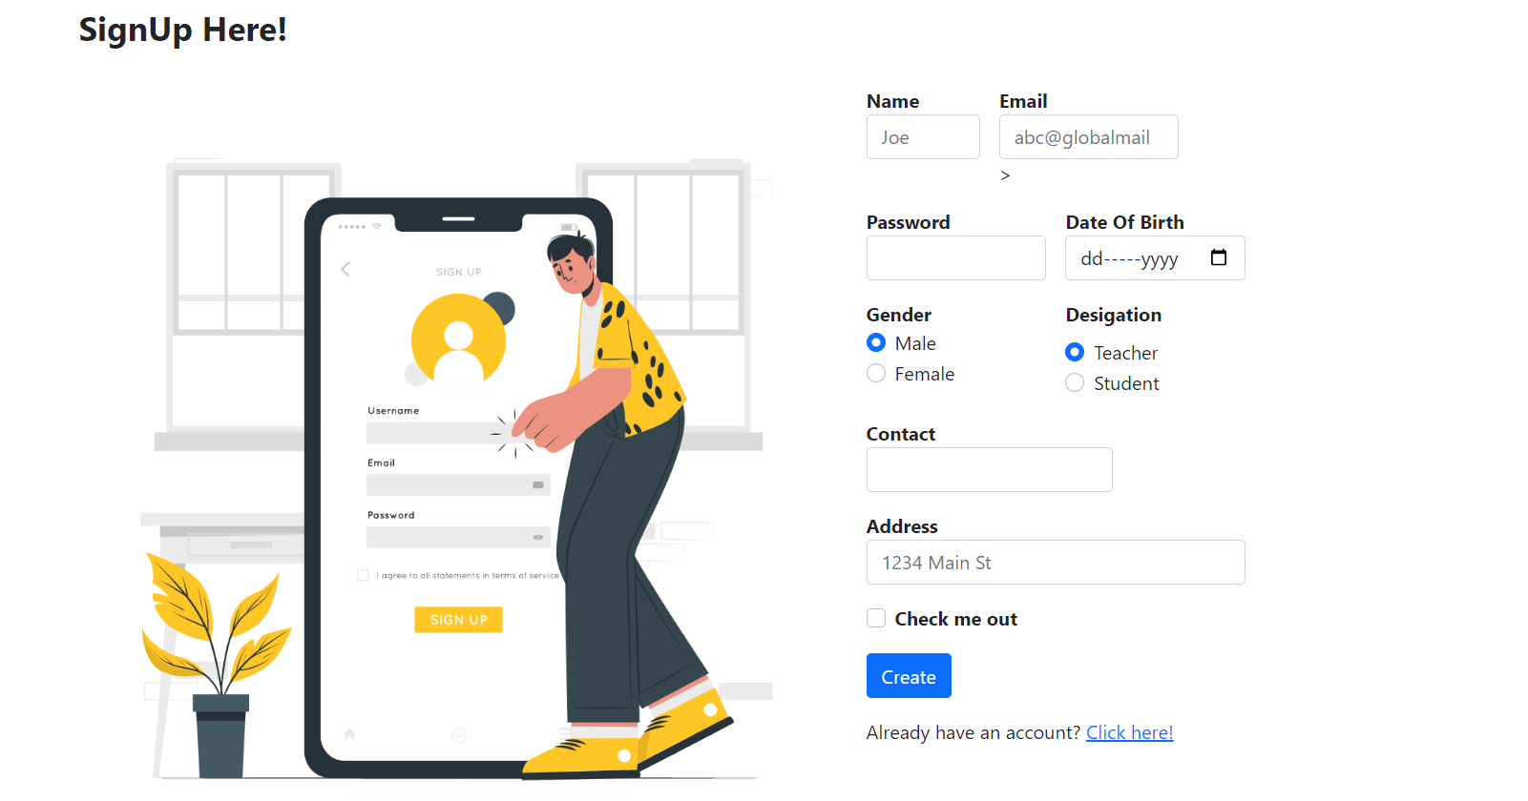
App Images

Slide 11
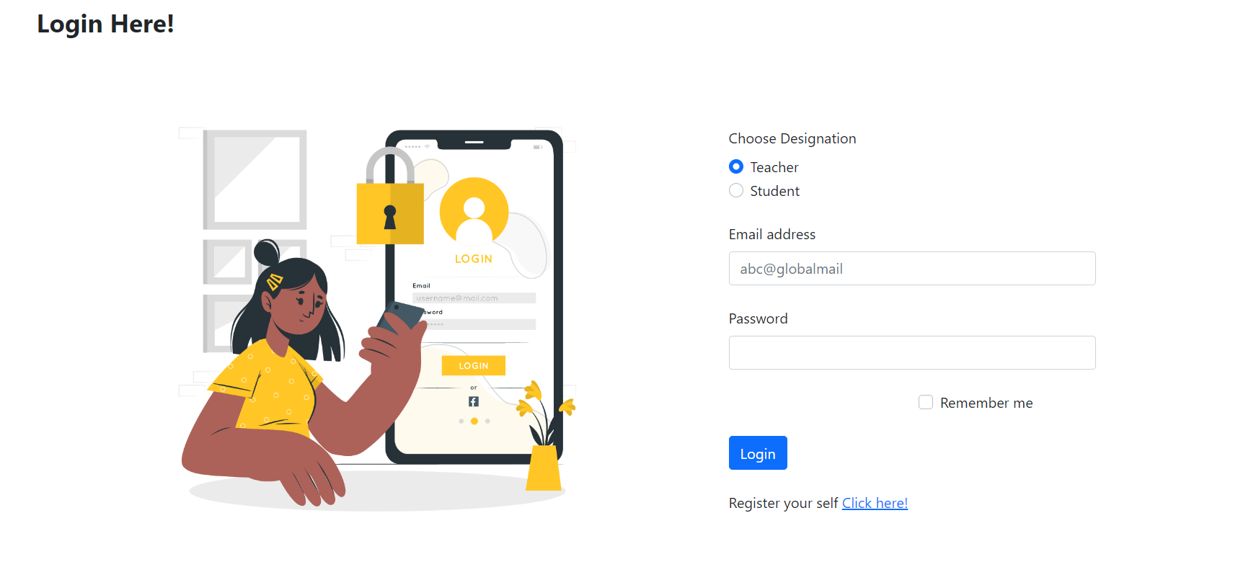
App Images

Slide 12


